Slide 1
“BLOG WEBSITE WITH APPLICATION”
Task - 1

Slide 2

Blog Website with Application
Blog Website Introduction
LMS Username | Name | Batch
au210620205019 | Greeshma Thomas | A26
au210620205030 | Niruthya Parkavi. P | A26
au210620205044 | Thanushyalakshmi .S | A26
au210620205011 | Catherine Gale. A | A26

Slide 3
Task - 1
Creation of SRS & Github
Creation & Set-Create SRS : “Your Project”
up of Github account
Creation & Hands-on to various commands of Git Bash
Evaluation Metric:
100% Completion of the above tasks
Learning Outcome
Get to know about different lifecycle models.
Understanding importance and how to create an SRS
Knowing various commands of Github
Understanding agile and scrum management techniques for efficient product development

Slide 4
SRS for Blog Website
Introduction:
The purpose of this document is to define the software requirements for a blog website. The blog website will provide a platform for users to create, publish and share articles, as well as read articles from other users.
A blog website may cover a wide range of topics, such as personal experiences, travel, cooking, health and wellness, politics, technology, business, and many more. The content can be written by a single author or a group of authors who contribute to the blog regularly.
Scope:
The scope of a blog website can vary depending on the goals and objectives of the website owner. Generally, a blog website is a platform that allows individuals, organizations, or businesses to publish articles, essays, reviews, or other forms of written content.
The scope of a blog website can be limited to a specific topic or audience, or it can be broad and cover a wide range of topics. The success of a blog website often depends on the quality and relevance of the content, the engagement with readers and followers, and the consistency and frequency of new content.

Slide 5
Purpose:
Building an online presence: Blogging can help individuals or businesses build their online presence and establish themselves as experts or thought leaders in their respective fields.
2.Marketing and promoting products or services: Blogging can be used as a marketing tool to promote products or services to potential customers.
3.Creating a community: Blogging can create a community of like-minded people who share similar interests and can interact with each other through comments and social media.
4.Generating revenue: Blogging can be a source of income through advertising, sponsorships, or selling products or services.
Functional Requirements:
1.User Authentication:
The website shall require users to authenticate before they can perform any actions on the site such as creating or commenting on posts.
2. User Registration:
The website shall allow new users to register and create an account. The registration process shall require the user to provide their name, email address, and password.
3. User Profile:
The website shall allow users to create a profile with their personal information such as name, profile picture, and biography

Slide 6
4. Post Creation:
The website shall allow users to create new posts. Posts shall have a title, body, and associated tags.
5.Post Editing:
The website shall allow users to edit their own posts.
6. Post Deletion
The website shall allow users to delete their own posts.
7. Post Searching:
The website shall allow users to search for posts by title, author, or Comment Creation.The website shall allow users to create comments on posts.
8. Post Sorting:
The website shall allow users to sort posts by date, popularity, or author
9.Comment Creation:
The website shall allow users to create comments on posts. Comments shall have a body and associated user.
10. Comment Editing:
The website shall allow users to edit their own comments.

Slide 7
11. Comment Deletion:
The website shall allow users to delete their own comments.
12. User Following:
The website shall allow users to follow other users to receive updates on their posts.
13. User Messaging:
The website shall allow users to send messages to other users.
14. User Notifications:
The website shall notify users of new comments, likes, and messages.
Non-Functional Requirements:
1. Performance:
The website shall load quickly and be responsive to user actions.
2. Security:
The website shall be secure and protect user data.

Slide 8
3. Compatibility:
The website shall be compatible with all modern web browsers.
4. Accessibility:
The website shall be accessible to users with disabilities.
5. Usability:
The website shall be easy to use and navigate.
Design Constraints:
1.User interface design:
The blog website must have a user-friendly and responsive user interface design that is easy to navigate and visually appealing to users.
2.Content management system:
The website must have a content management system (CMS) that allows users to easily create, edit, and publish blog posts and pages.

Slide 9
3.Scalability:
The website must be designed to handle high traffic loads and accommodate future growth in terms of users and content.
4.Security:
The website must be secure, with features such as SSL encryption, strong password policies, and protection against common vulnerabilities like SQL injection attacks.
5.Compatibility:
The website must be compatible with a range of devices and web browsers, including mobile devices.
6.Search engine optimization (SEO):
The website must be optimized for search engines, with features such as meta tags, sitemaps, and search engine-friendly URLs.
7.Accessibility:
The website must be designed to be accessible to users with disabilities, following accessibility guidelines such as WCAG 2.0.
8.Performance:
The website must be optimized for fast page load times, with features such as caching, content delivery networks (CDNs), and optimized images.

Slide 10
9.Database design:
The database used by the website must be designed to handle the expected load of data and provide efficient querying and storage of data.
10.Integration:
The website must be able to integrate with other third-party services and tools, such as social media platforms, analytics tools, and email marketing services.
Preliminary Schedule and Budget:
Schedule:
Planning and research: 1-2 weeks
Define the target audience, purpose of the blog, and content strategy.
Research the competition and analyze successful blogs in your niche.
Design and development: 6-8 weeks
Create a design concept for the website and obtain approval from stakeholders.
Develop the website using a content management system (CMS) such as WordPress or Squarespace.
Content creation: Ongoing
Plan and create high-quality, engaging content for the blog.

Slide 11
4.Launch and promotion: 1-2 weeks
Conduct testing and debugging of the website.
Launch the website and promote it through social media, email marketing, and other channels.
Budget:
Domain name: $10-$15 per year
Web hosting: $5-$50 per month
Website design and development: $3,000-$10,000
Content creation: Varies depending on the amount and quality of content needed.
Launch and promotion: Varies depending on the marketing channels used.
Appendices:
Glossary:
A glossary provides definitions for technical terms, jargon, or industry-specific words that might be unfamiliar to the website's readers. This can be helpful in clarifying concepts and improving the overall understanding of the content.
Bibliography:
A bibliography lists the sources that were used to create the content on the website. This can help readers to find more information about a particular topic or to verify the accuracy of the information presented.

Slide 12
Assessment Parameter
Gather requirements for the project
add Readme.md file with description of the project
Prepare database design schemas
Check-List
Commit all changes with "first commit"
Get your initial project Structure ready
create a repository on github realted to project
Initiate a git repository
Push your changes to github

Slide 13
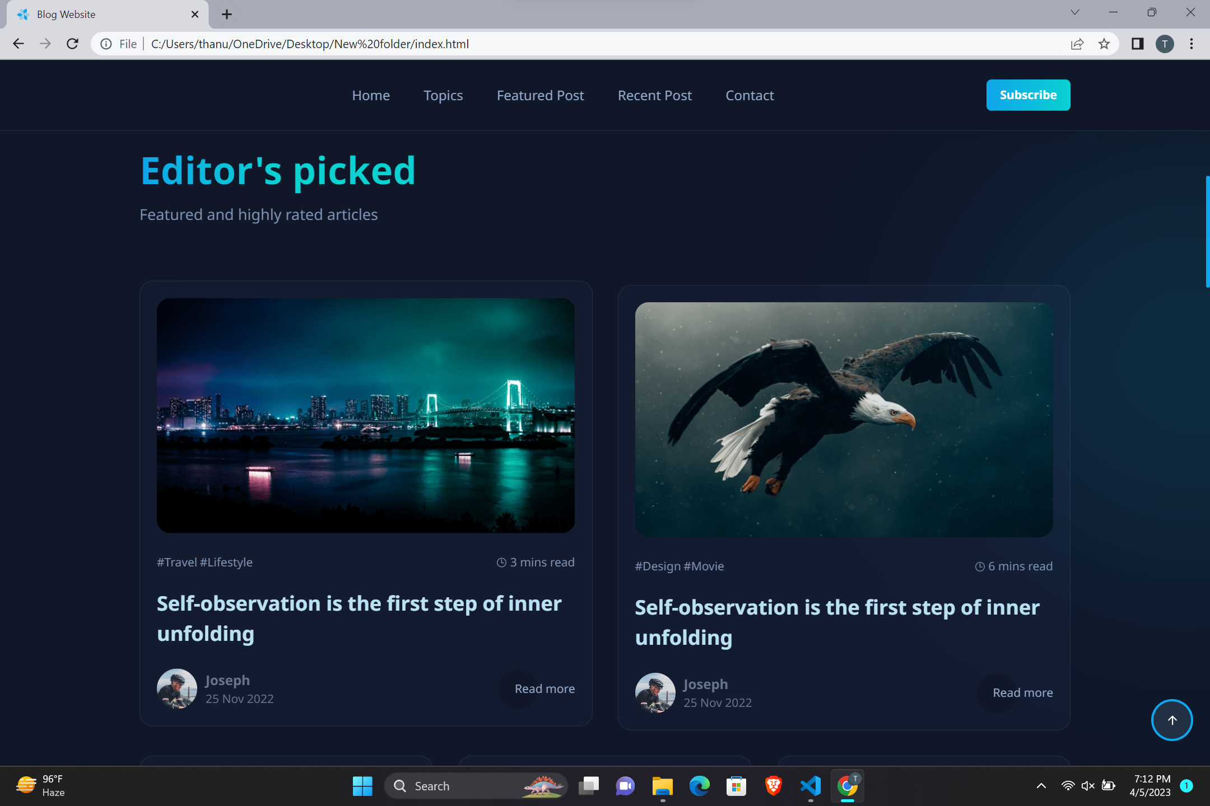

Slide 14
Submission Github
https://github.com/Thanushyalakshmi/gitThanushya/blob/main/New%20folder/index.html

